Slide 1
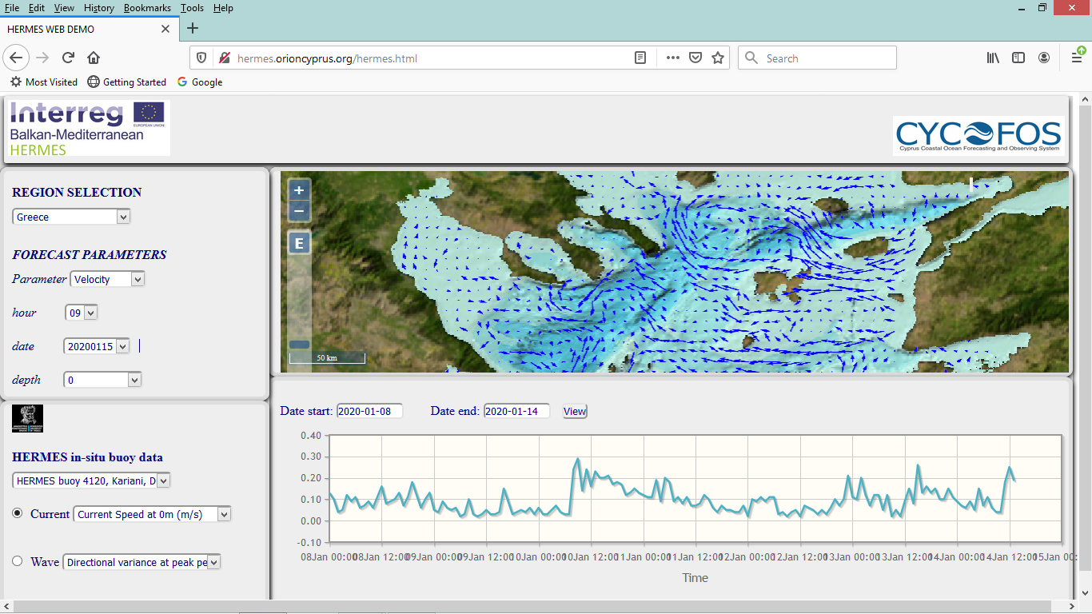
HERMES web GIS: a) HERMES buoy at Kariani, Greece: in-situ sea surface currents b) forecasting sea surface currents in the northern Aegean sea

Slide 2
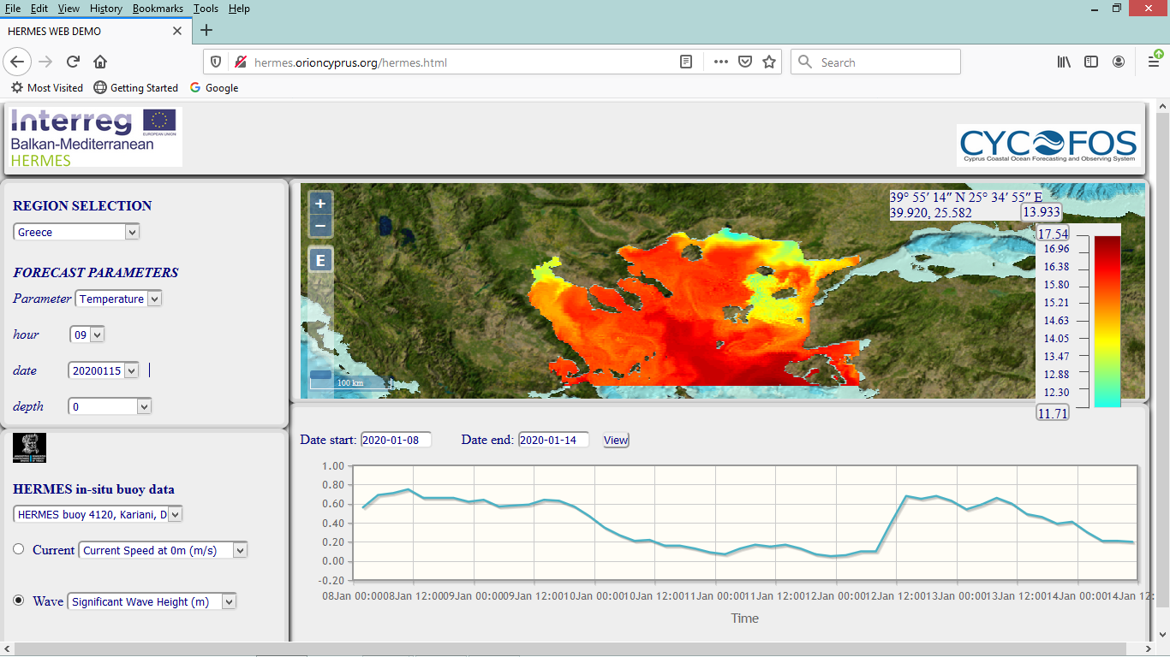
HERMES web GIS: a) HERMES buoy at Kariani, Greece: in-situ significant wave height b) forecasting sea surface temperature in the northern Aegean sea

Slide 3
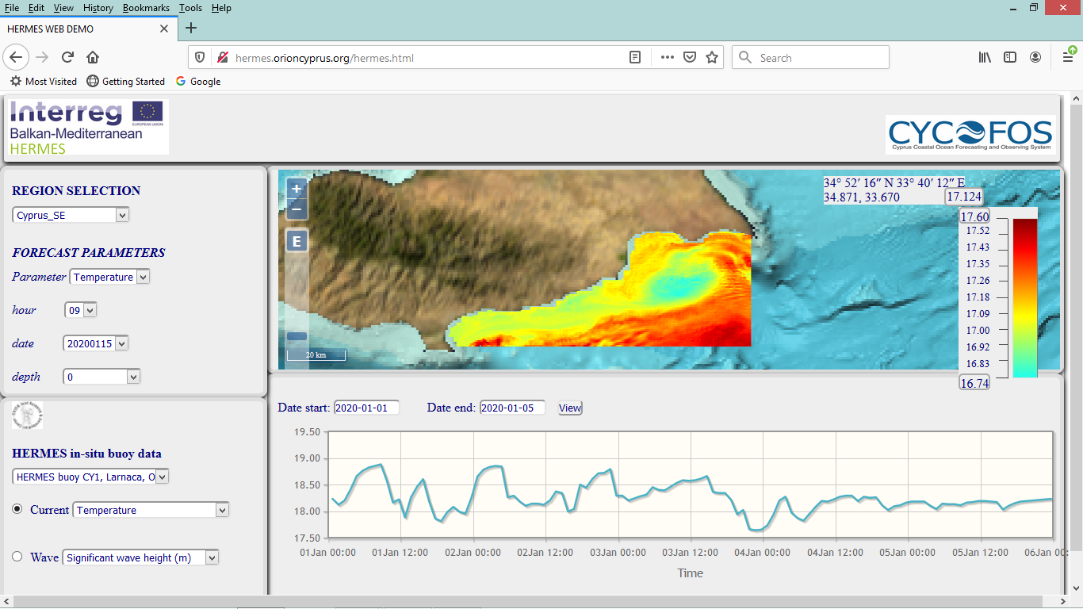
HERMES web GIS: a) HERMES buoy at Larnaca bay, Cyprus: in-situ temperature at 40 m b) forecasting sea surface temperature in the SE Cyprus

Slide 4
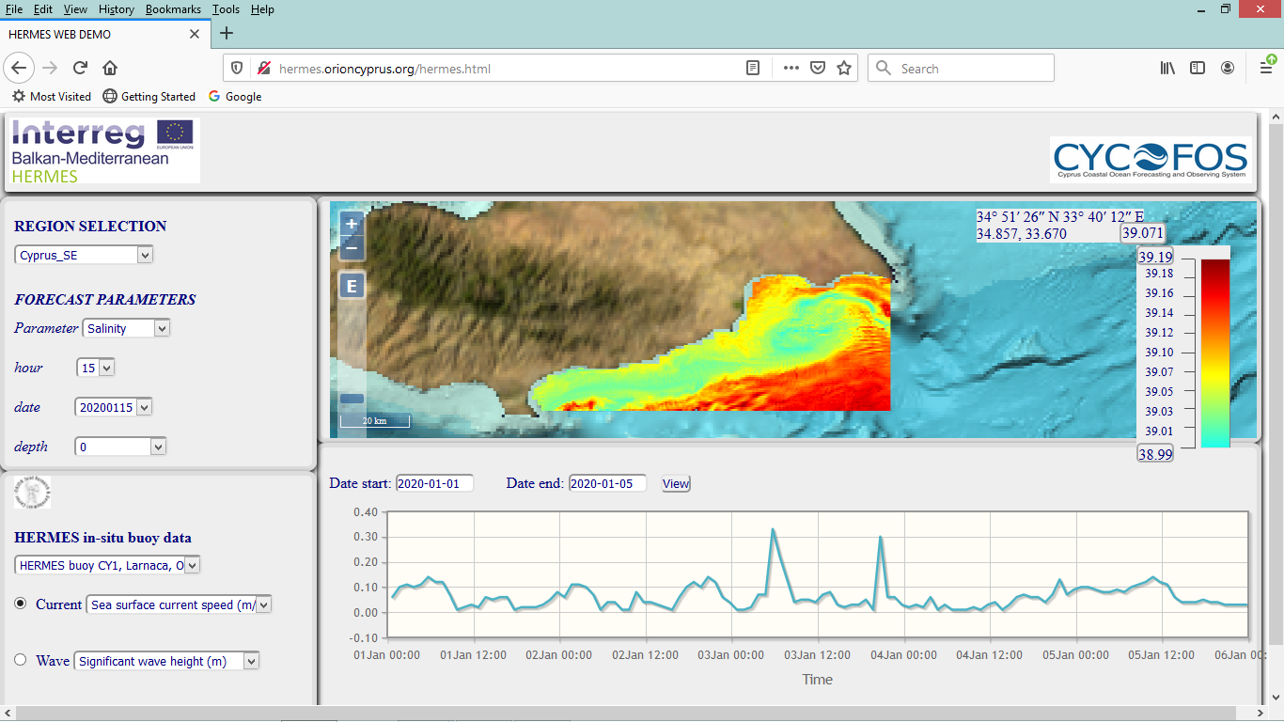
HERMES web GIS: a) HERMES buoy at Larnaca bay, Cyprus: in-situ sea surface currents b) forecasting sea surface salinity in the SE Cyprus

Slide 5
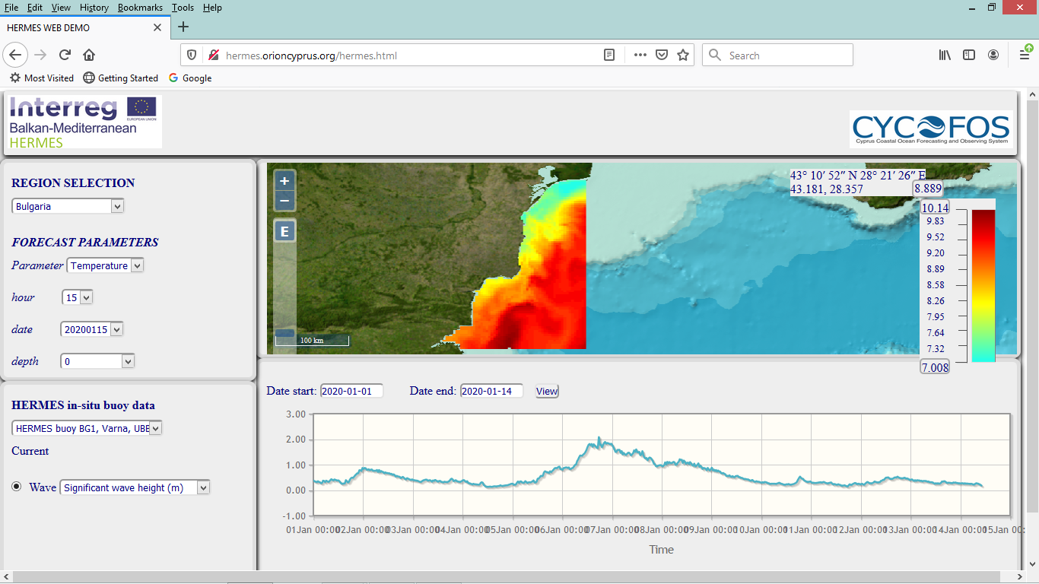
HERMES web GIS: a) HERMES buoy at Varna bay, Bulgaria: in-situ significant wave height b) forecasting sea surface temperature in the Bulgarian coastal zone

Slide 6
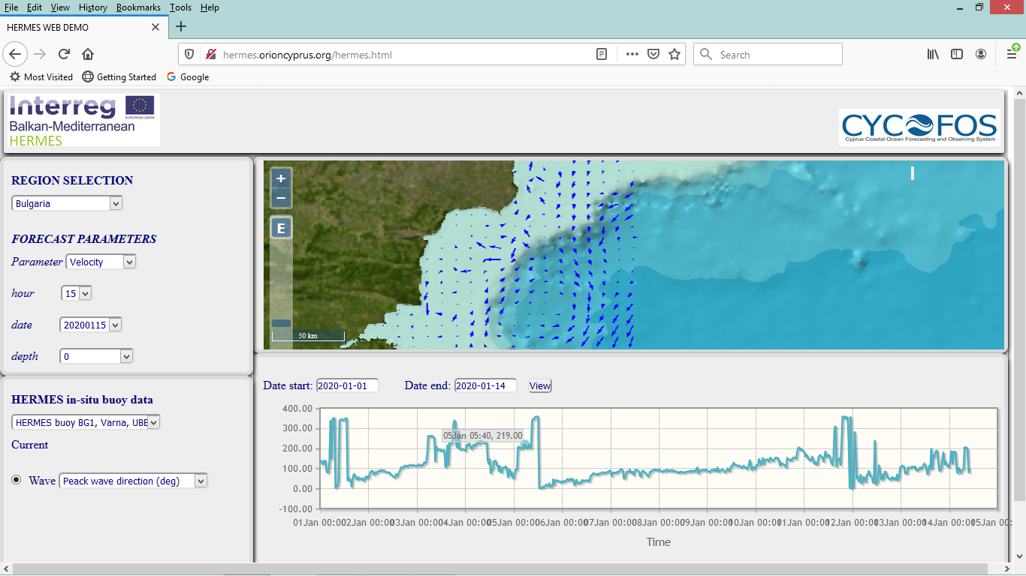
HERMES web GIS: a) HERMES buoy at Varna bay, Bulgaria: in-situ peak wave direction b) forecasting sea surface currents in the Bulgarian coastal zone

Slide 7
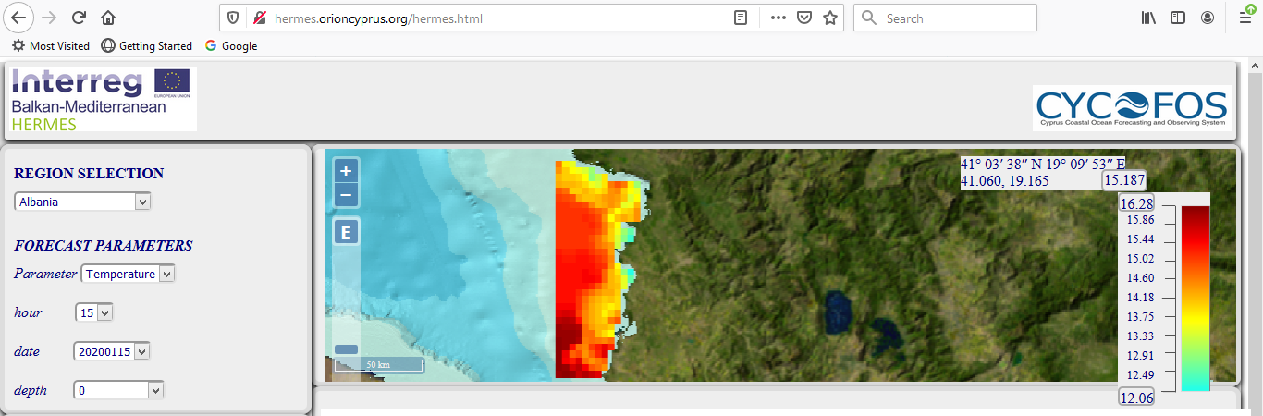
HERMES web GIS: b) forecasting sea surface temperature in the Albanian coastal zone

