Slide 1
CrowdStream CROWDfunding to mainSTREAM innovation Digital training course Pannon Business Network
Varna, Bulgaria | May 28, 2019
Project co-funded by the European Union

Slide 2
Digital training course
Training material on crowdfunding
Digital Training Materials for BSOs on how to support start-ups and social enterprises interested in CrowdFunding
To be developed out of the already available curricula and feedback on the trainings (WP5 Core Team + PBN)
Online Moodle Platform to include:
CrowdStream Training Materials in the form of online courses;
PDF Training Materials to be available for download;
Possibly, evaluation tests at the end of the training modules.
Project co-funded by the European Union

Slide 3
Digital training course
Training material on crowdfunding
6 modules
26 training units
6 tests
2 learning paths:
Modules 1 – 4: Crowdfunding for Final Beneficiaries
Modules 1 – 6: Crowdfunding for BSOs
+ TU27: Guide on how to approach trainings
+ PowerPoint Presentations per each module
Project co-funded by the European Union

Slide 4
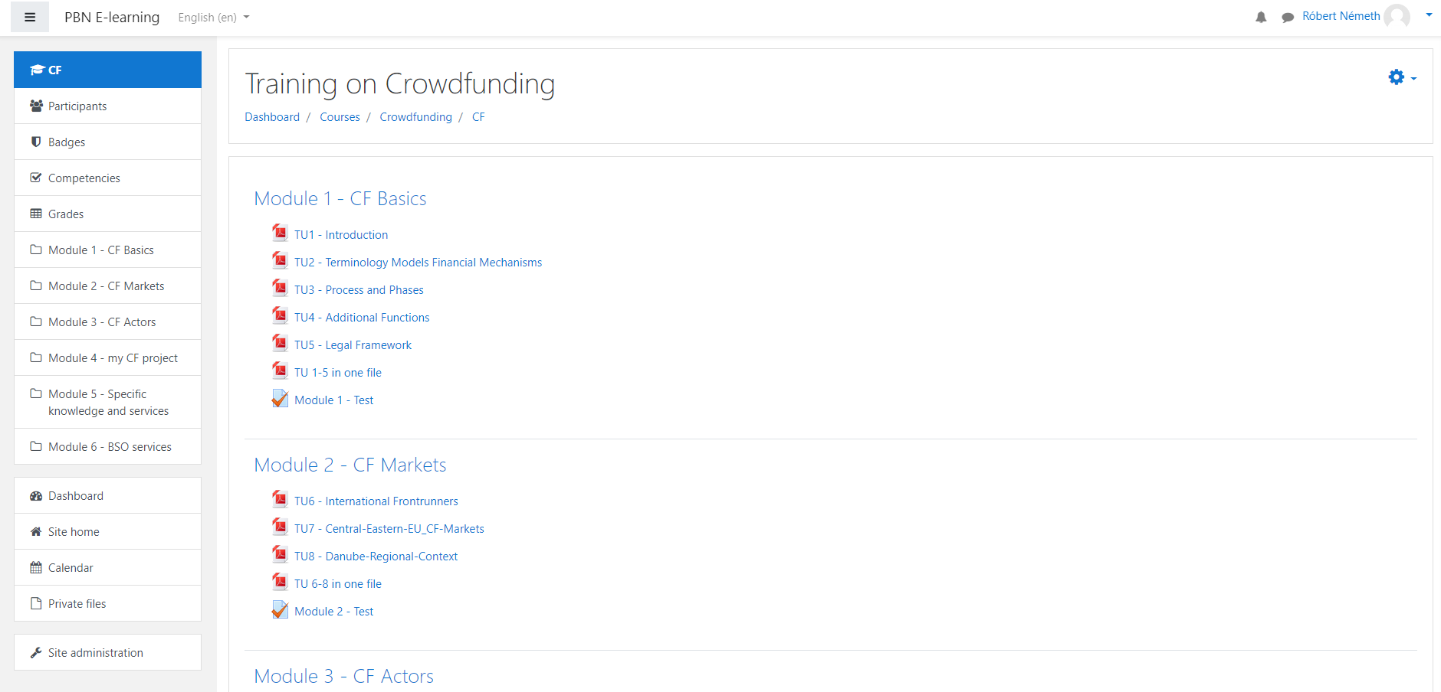
WP5 - Capacity building
5.3: Training material on crowdfunding
Project co-funded by the European Union

Slide 5
Digital training course
Project co-funded by the European Union

Slide 6
Thank you!
www.pbn.hu
robert.nemeth@pbn.hu
Project co-funded by the European Union
Notes:
WP2 PITCHING VIDEO REMINDER!

