Slide 1
CrowdStream CROWDfunding to mainSTREAM innovation Training and Capacity Building Package Styrian Technology Park
Varna, Bulgaria | May 28, 2019
Project co-funded by the European Union

Slide 2
OBJECTIVES
Increase knowledge and capacity of relevant actors
Increase awareness among SMEs and Innovative Enterprises
Reduce wrong expectations on CrowdFunding
Increase
public actors competencies
for a qualitative CrowdFunding
on requirements for a successful campaign
for them to support SMEs
Project co-funded by the European Union
Notes:
Increase knowledge and capacity of relevant actors for qualitative CrowdFunding through a set of innovative training materials
Increase awareness among SMEs and innovative enteprises on what is required to deliver a successful campaign
Reduce wrong expectations on CrowdFunding
Increase public actors and institutions’ competencies for them to support SMEs

Slide 3
TIMELINE
March, 2018
TRAINING CURRICULA DEVELOPMENT
Curricula and presentations, the basis to train start-ups and social enterprises
August, 2018
TRAINING CURRICULA FINALISATION
Consolidated CrowdStream Training Guide
Basic and Advanced levels, 6 Modules, 27 Training Units
Project co-funded by the European Union

Slide 4
TIMELINE
September, 2018
SMEs & INNOVATIVE ENTERPRISES TRAININGS START OFF
Boosting the development of small companies through new tactics on alternative financing
October, 2018
BSOs TRAININGS START OFF
Training public actors on developing, implementing and capitalising support services for SMEs
Project co-funded by the European Union

Slide 5
TIMELINE
January, 2019
DIGITAL TRAINING MATERIALS
Developing a set a digital training materials designed especially for business support organisations
May, 2019
DIGITAL CROWDSTREAM PLATFORM RELEASE
Public release of the digital training materials and educational Moodle platform
Project co-funded by the European Union

Slide 6
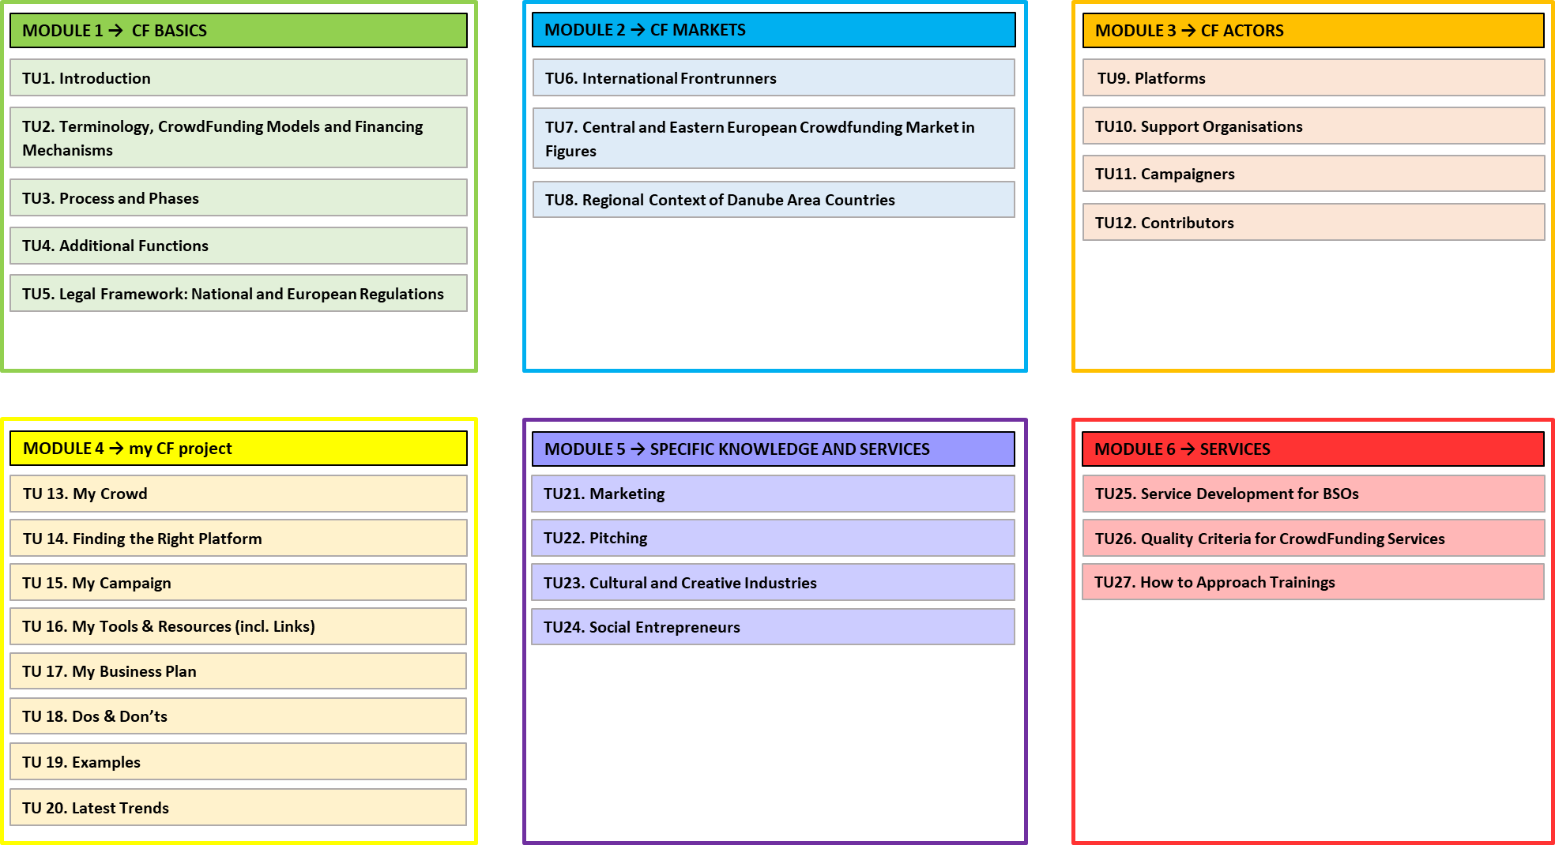
TRAINING CURRICULA
6
TRAINING
MODULES
27
TRAINING
UNITS
3
LEVELS OF
PROGRESS
Project co-funded by the European Union

Slide 7
BASIC BENEFICIARIES
Project co-funded by the European Union

Slide 8
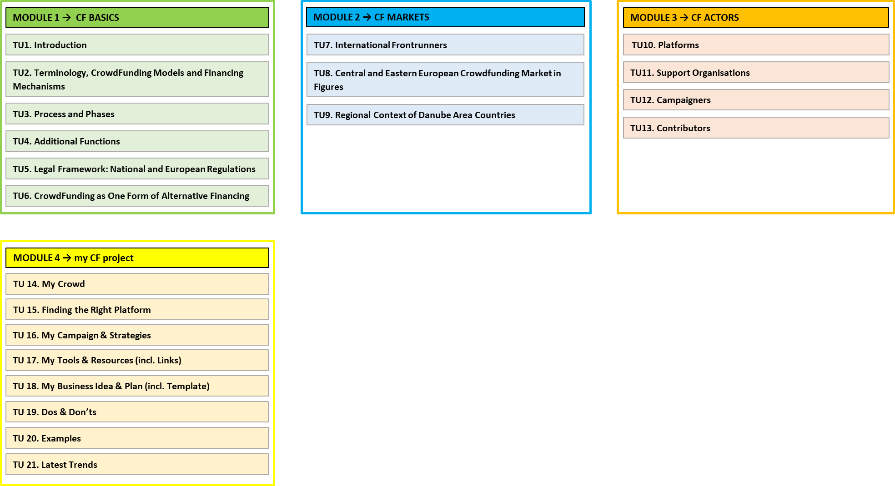
ADVANCED BENEFICIARIES
Project co-funded by the European Union

Slide 9
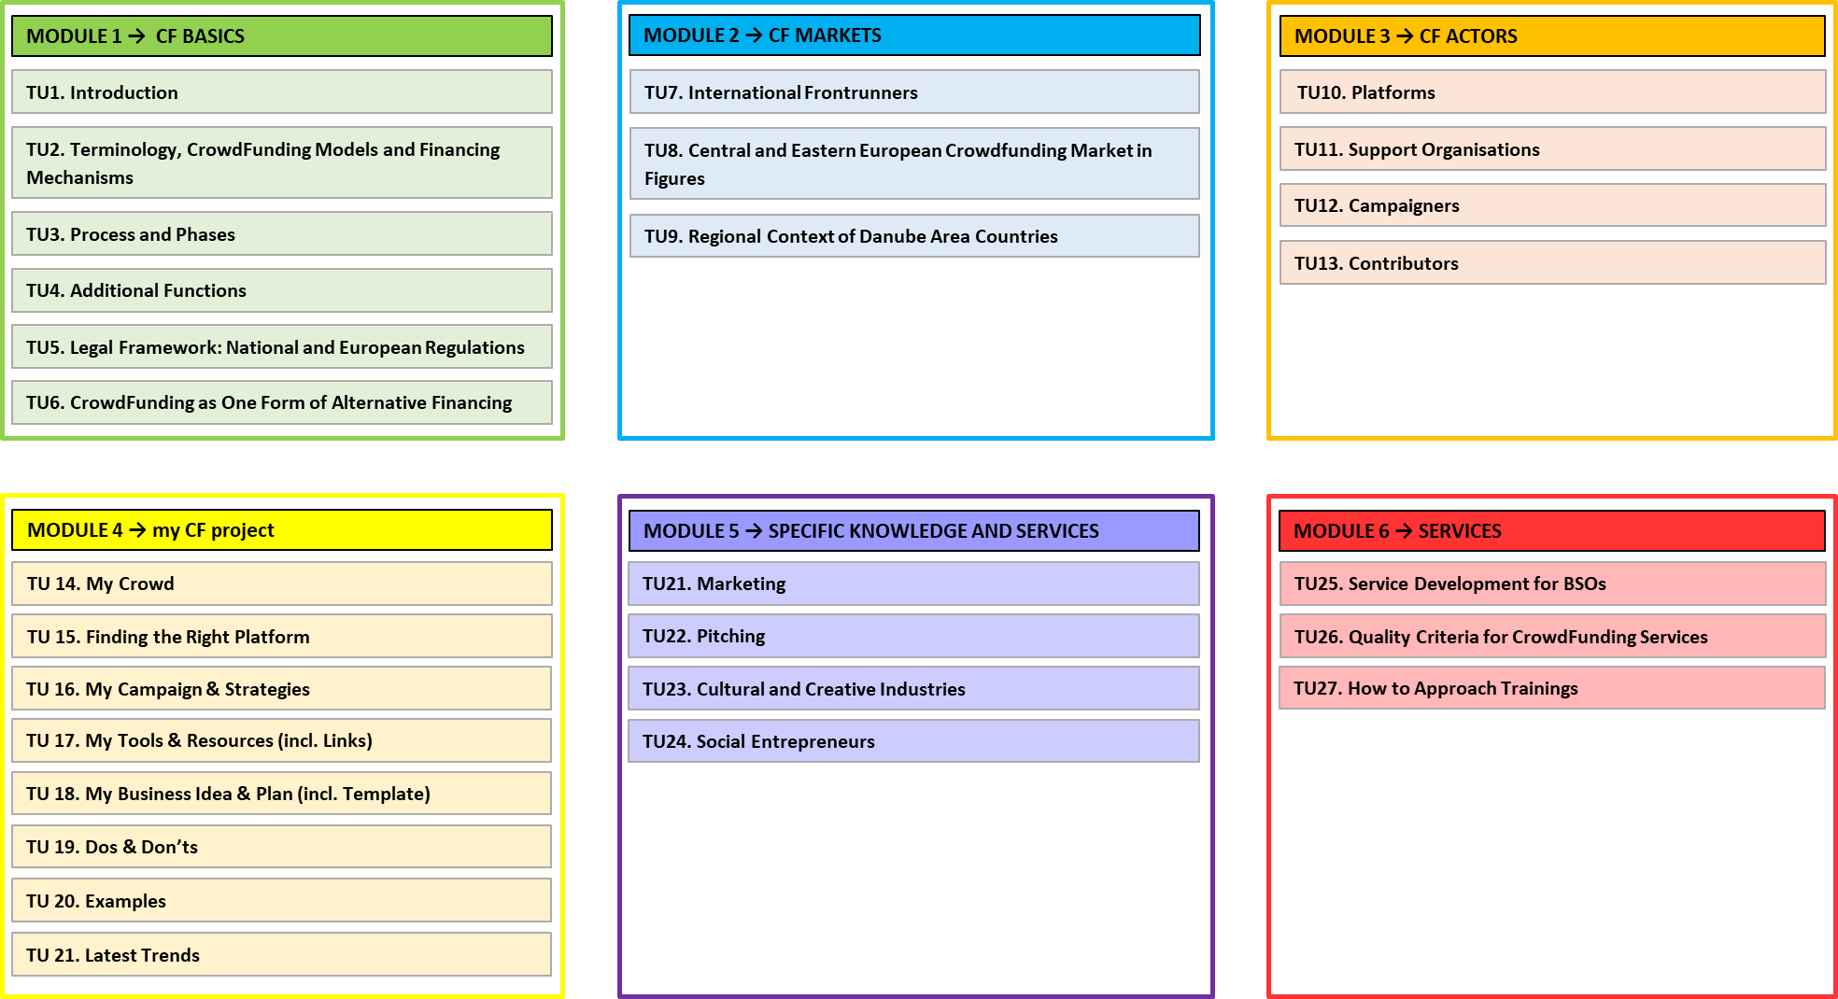
BSOs
Project co-funded by the European Union

Slide 10
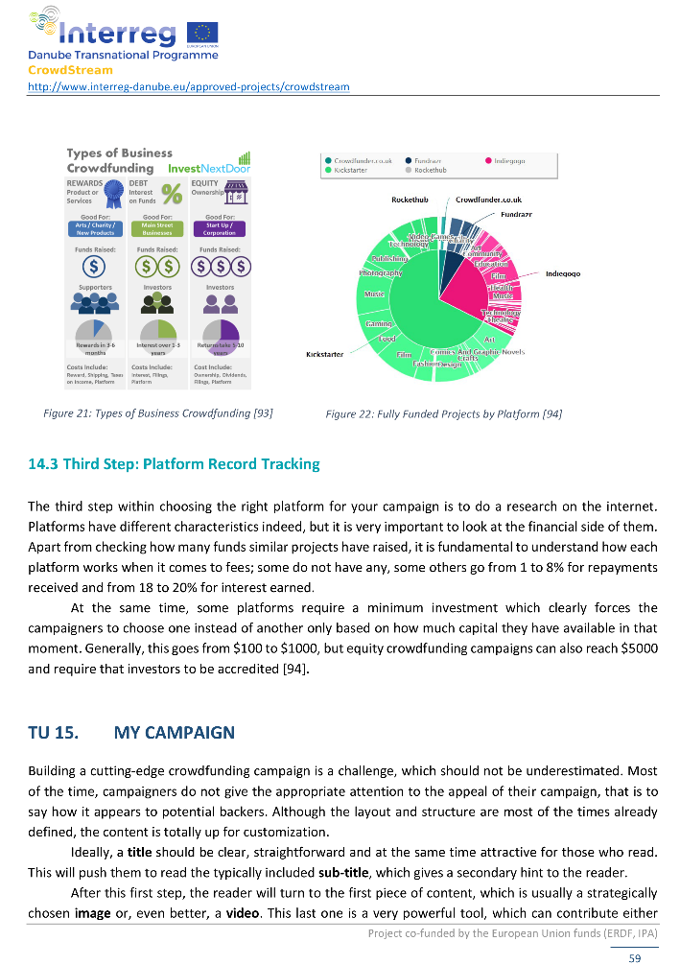
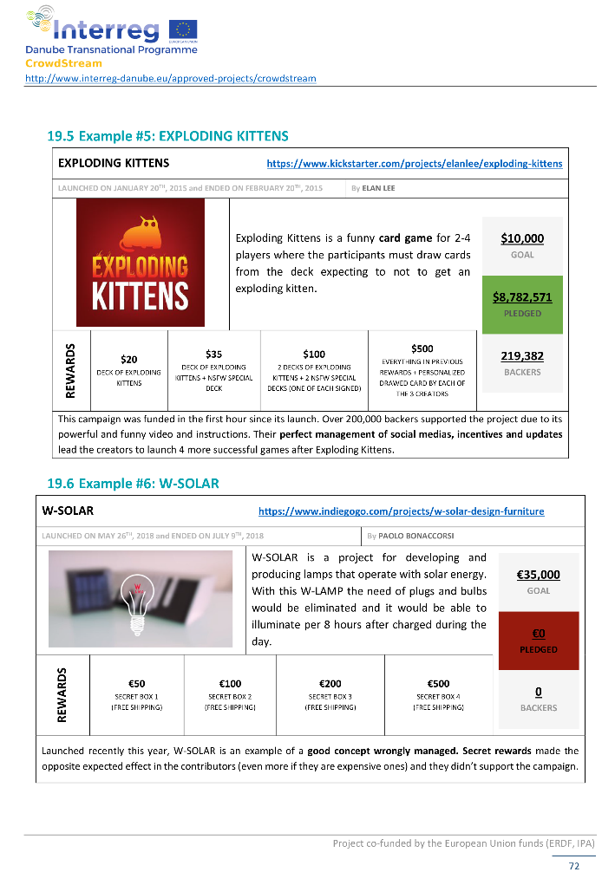
CROWDSTREAM TRAINING GUIDE
130 PAGES
AVAILABLE IN:
PDF
FORMAT
POWER
POINT
VERSION FOR TRAININGS
Project co-funded by the European Union

Slide 11
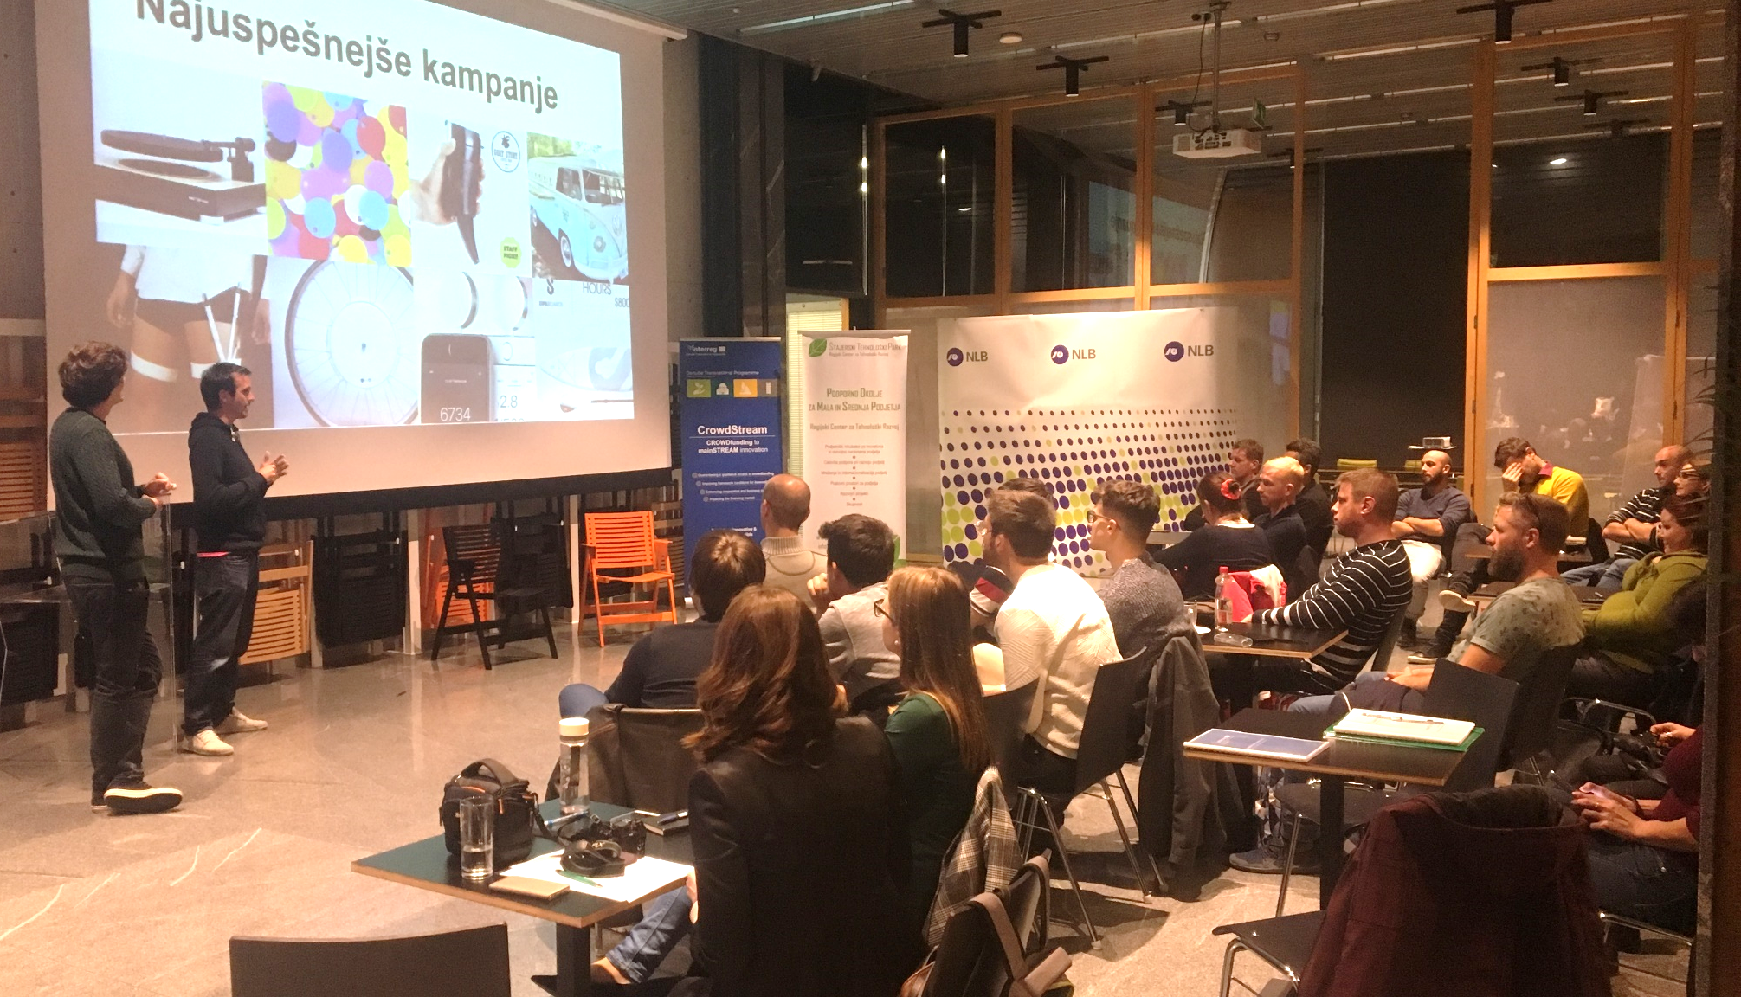
SMEs & INNOVATIVE ENTERPRISES TRAININGS
OUR GOAL
ACHIEVED
18
Training
Sessions
180
Trained SMEs and Innovative Enterprises
21
Training
Sessions
280
Trained SMEs and Innovative Enterprises
Project co-funded by the European Union

Slide 12
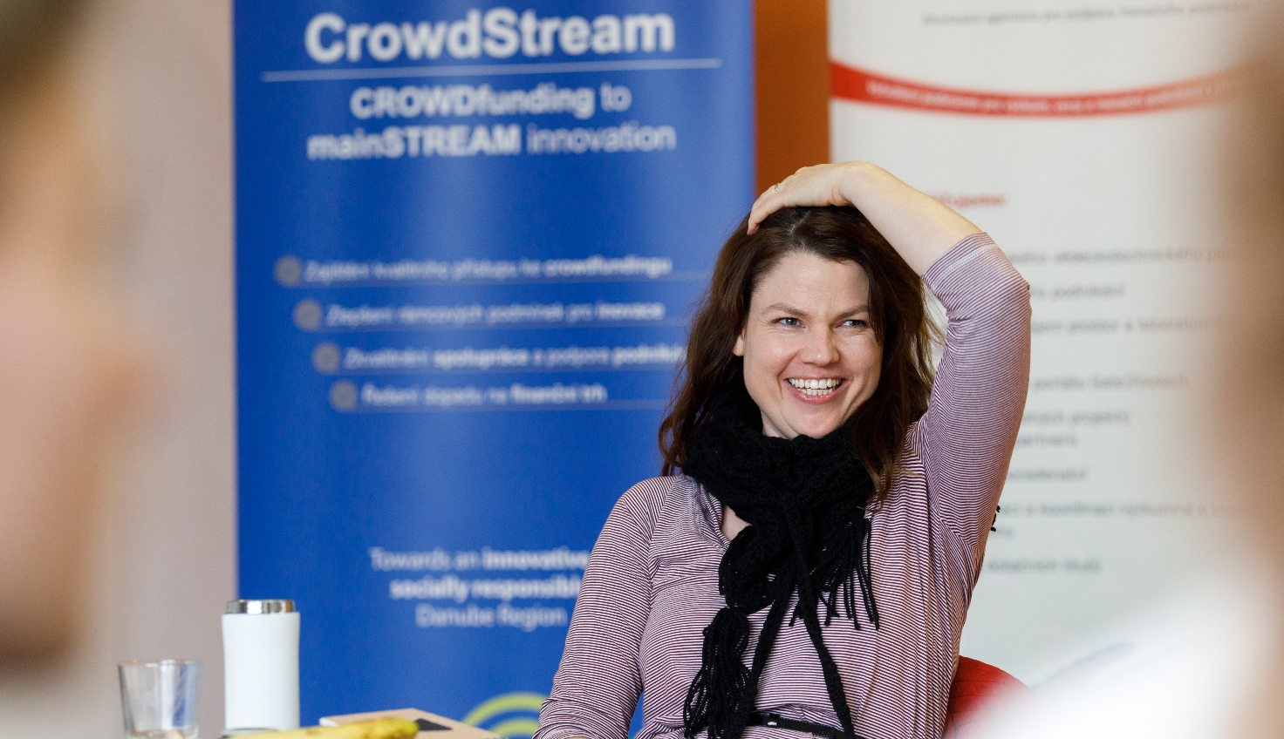
SMEs & INNOVATIVE ENTERPRISES TRAININGS
OUR GOAL
ACHIEVED
18
Training
Sessions
180
Trained SMEs and Innovative Enterprises
21
Training
Sessions
280
Trained SMEs and Innovative Enterprises
Project co-funded by the European Union

Slide 13
BSOs TRAININGS
OUR GOAL
ACHIEVED
18
Training
Sessions
100
Trained BSOs
Officers
19
Training
Sessions
143
Trained
BSOs
Project co-funded by the European Union

Slide 14
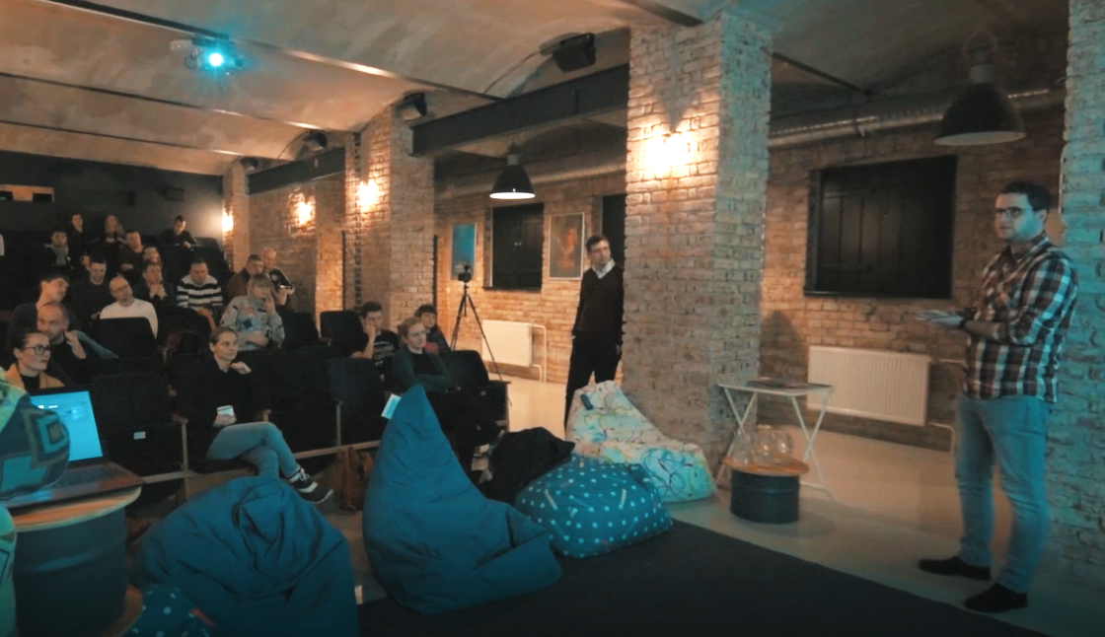
BSOs TRAININGS
OUR GOAL
ACHIEVED
18
Training Sessions
19
Training
Sessions
143
Trained BSOs
Officers
Project co-funded by the European Union

Slide 15
SUSTAINABILITY
Based on the identified interests of both target groups, trainings shall continue after the end of the CrowdStream project.
Project co-funded by the European Union

Slide 16
Thank you!
www.stp.si | info@stp.si
Project co-funded by the European Union

