Slide 1
Energy Financing Mix
Innovative Financing Opportunities for Energy Efficiency
Alexandra Pintilie, ConPlusUltra Ltd.
CrowdStream Conference, 28th May 2019, Varna

Slide 2
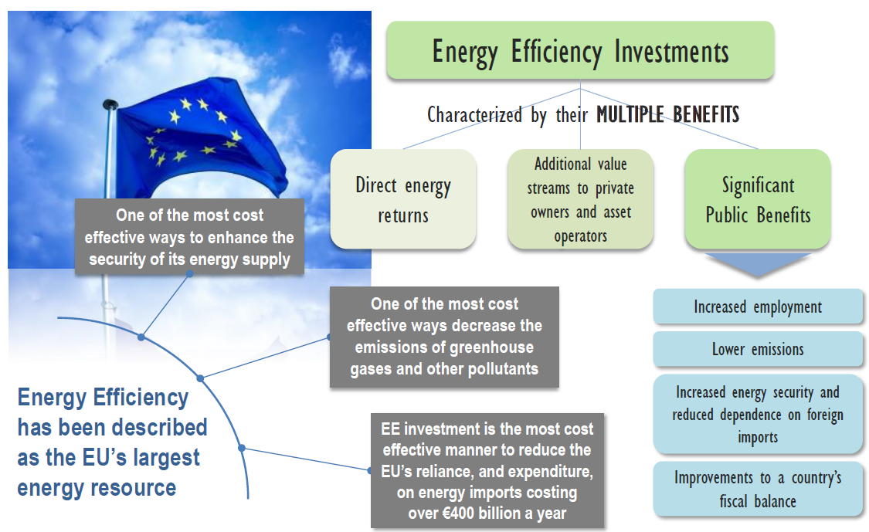
The Energy Efficiency Paradigma
Lack of (private) investments in EE improvements
Still challenges ahead to improve EE above minimal legal requirements
Delay in implementation of EE investments, especially in private sector because of
  long payback times
  lack of financing means
Lack of knowledge/experience using innovative financing mechanisms
vs.
(Quelle: EEFIG, 2015)

Slide 3

E-FIX wants to remove barriers between investors and project developers

Slide 4

Innovative financing mechanisms
Crowdfunding/-investing
Equipment Leasing
Energy performance contracting
E-FIX aims at triggering private finance for sustainable energy projects by focussing on specific financing mechanisms

Slide 5
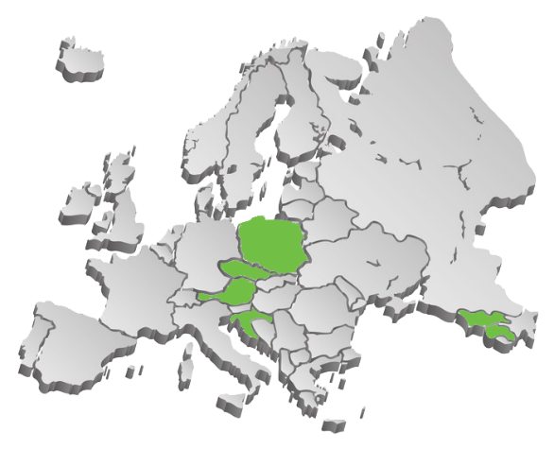

E-FIX is moving along 3 directions
TRANSFER KNOWLEDGE
  Within the Project Partnership: AT, CZ, HR, PL, GE, AM
BUILD CAPACITIES
  Increasing the competencies of market actors, in regard to energy and financing requirements
  Training of „Ambassadors“ for innovative financing of energy projects
ROLL OUT
  Strengthening national/regional structures for the innovative financing of energy projects in the partner countries
  Test and disseminate tailored innovative energy financing mechanisms
  Thereby increasing the investments in the energy sector
1
2
3

Slide 6
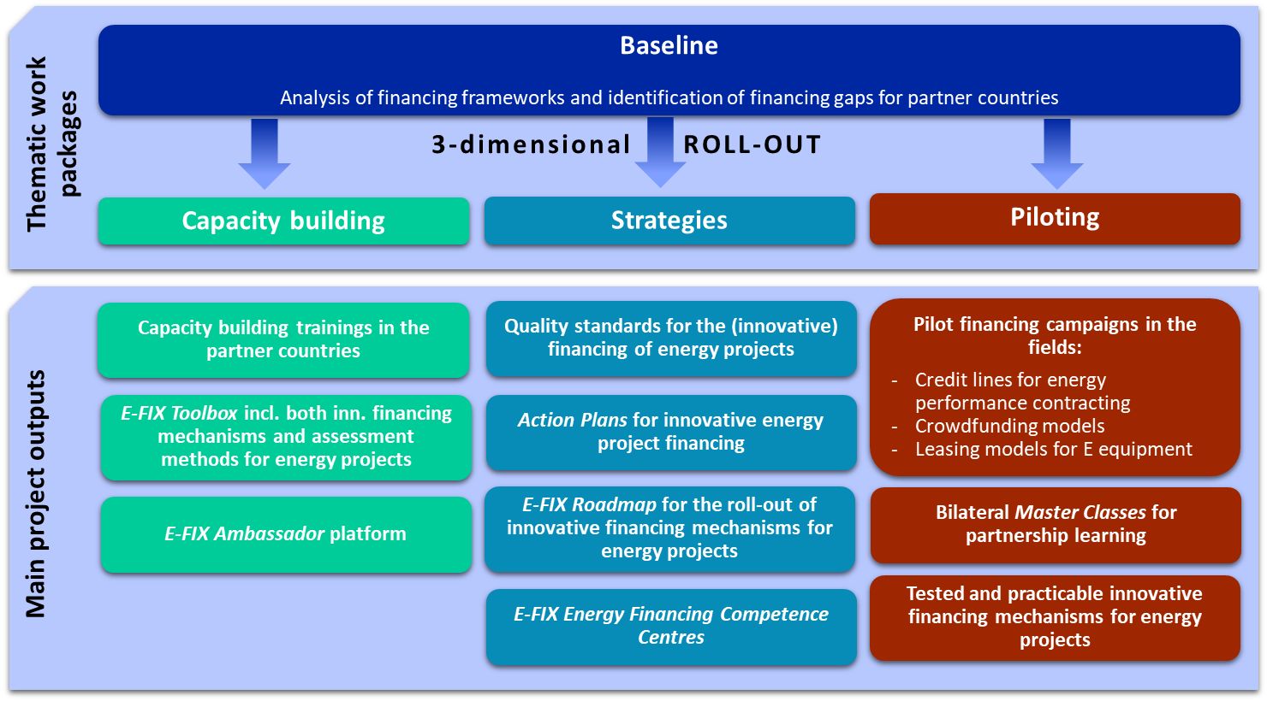
E-FIX is moving along 3 directions

Slide 7
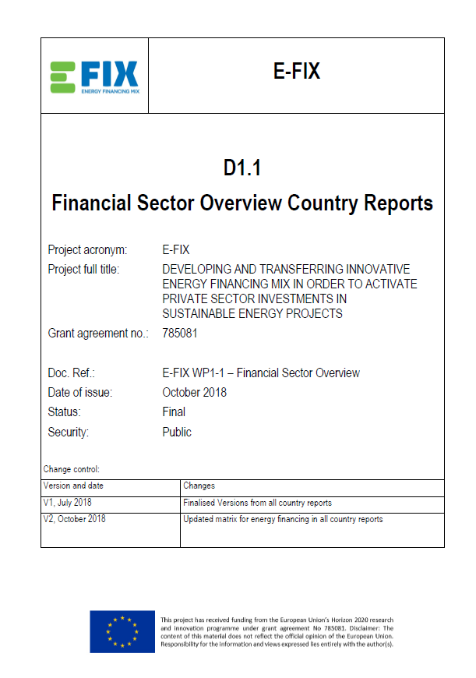
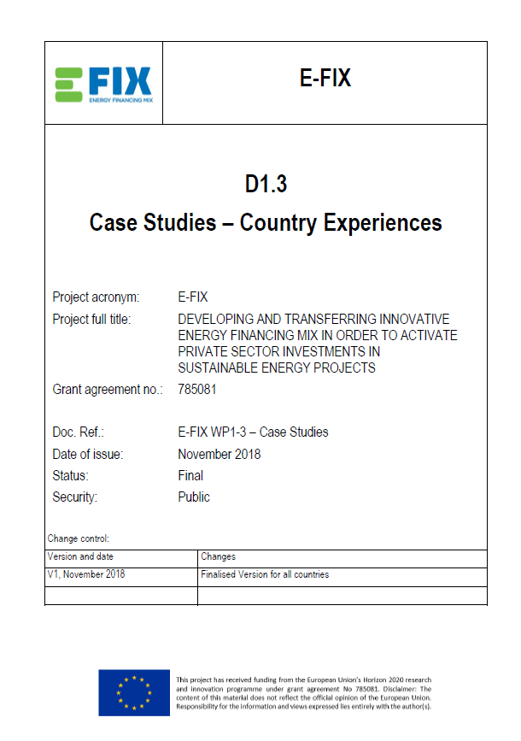
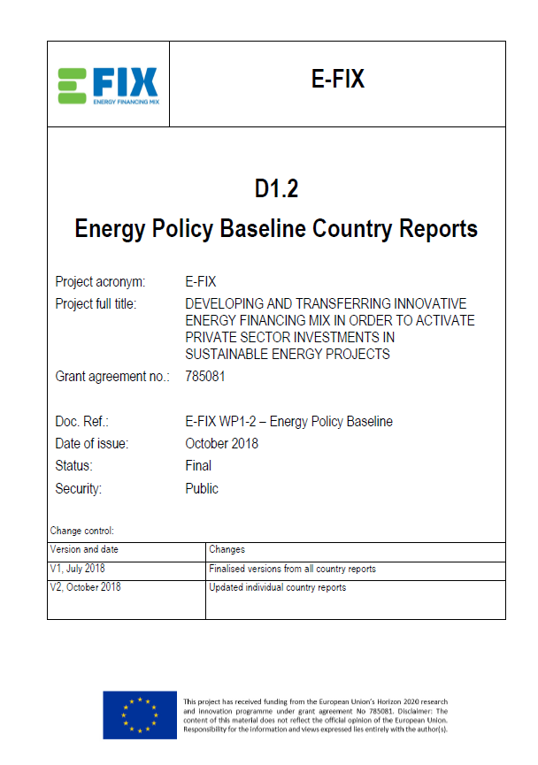
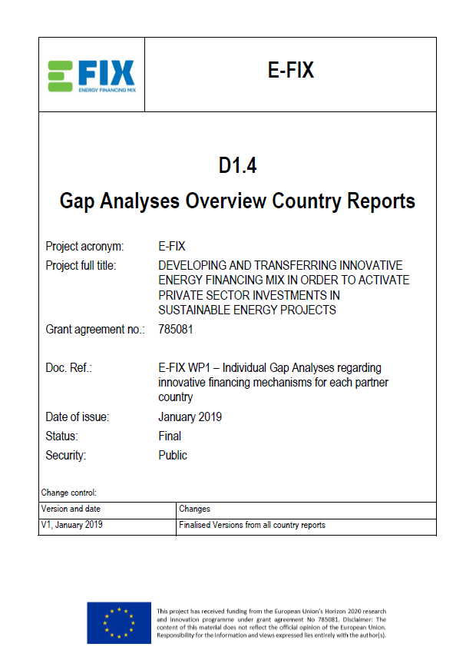
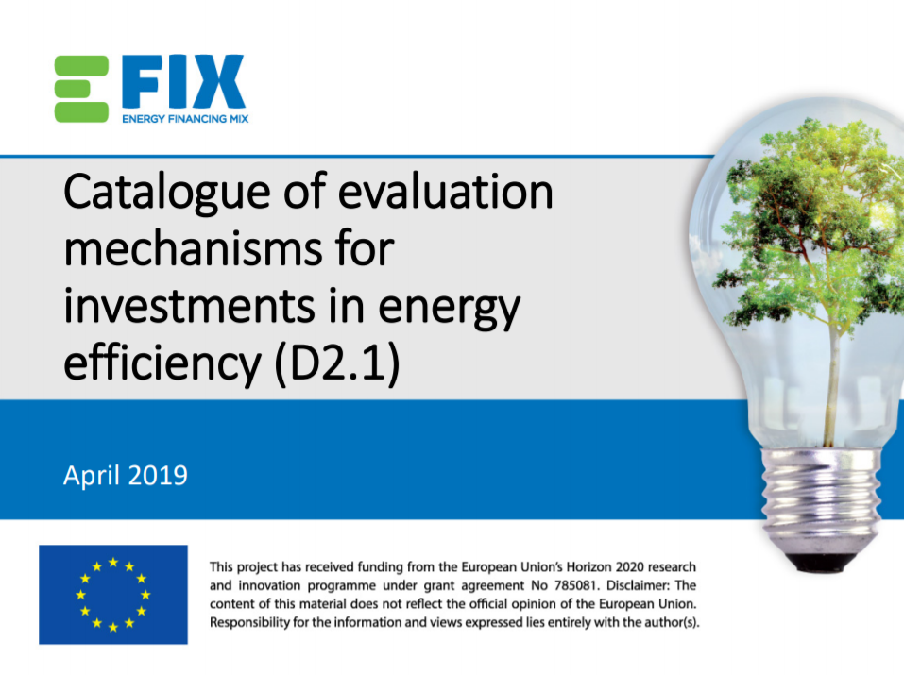
Already available results
Financing & Energy Policy Baseline for each partner country
Case study analysis of alternative financing of energy projects in each partner country
Individual gap analyses for validating the preselection of the innovative financing mechanism
Catalogue of evaluation methods for the systematic assessment of sustainable energy projects
All reports available on the E-FIX webpage: www.energyfinancing.eu

Slide 8

Focus: Capacity Building
Training curriculum
Didactics and engaging the audience
Catalogue of evaluation methods for the systematic assessment of sustainable energy projects
General modules addressing each financing mechanism
  Leasing
  Crowdfunding
  EPC
Specialist finance following case-based teaching methods
Toolbox
preparation of projects; matching of adequate financing methods & partners
Training Materials & Digital Course

Slide 9
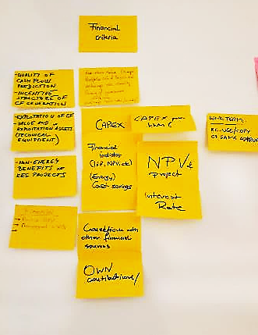
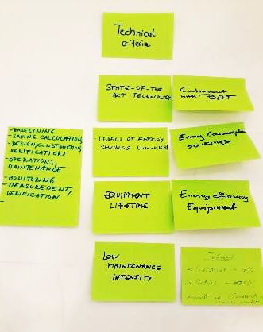
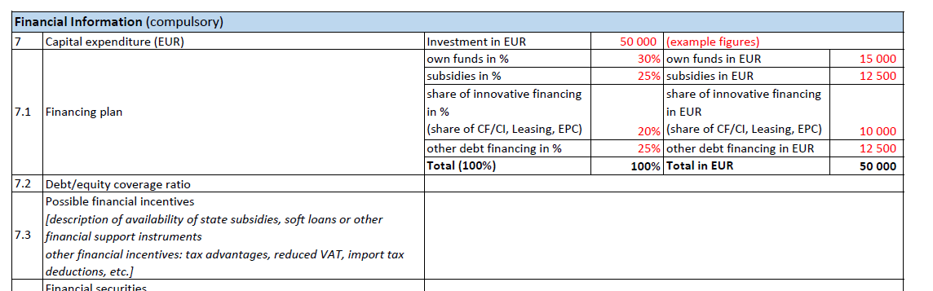
Focus: Quality Criteria
Common standards for financing of energy projects
technical, financial, environmental & other relevant criteria
compulsory & optional criteria
minimum of common criteria across all three financing mechanisms & specific criteria for each of them

Slide 10


Focus: Financing Campaigns
Pilot campaigns
start in autumn 2019
involvement of relevant stakeholders (project owners, energy providers, finance institutes, ESCOs, community and interest groups… )
test and implementation of the E-FIX methodology in real-life environments, in each of the six partner countries

Slide 11



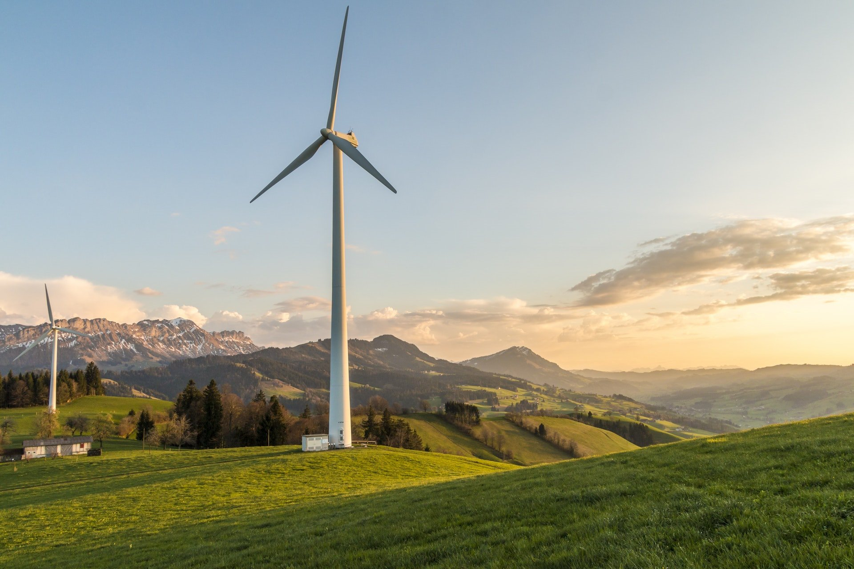
E-FIX: Expected Impacts
1 E-FIX Roadmap
6 Action Plans
120 E-FIX Ambassadors
Pilot financing campaigns, investment
~ 8 mill. EUR
6 Energy Financing Competence Centers
Renewable energy triggered
~ 1.6 GWh/yr
Energy savings triggered
~ 19 GWh/yr

Slide 12
E-FIX Event
Save the date
Mid-term Conference
16.-17.10.2019
Zagreb, Croatia
Web: www.energyfinancing.eu
FB: Project E-FIX

Slide 13
THANK YOU!
Andreas Karner – Project Coordinator
andreas.karner@conplusultra.com
Alexandra Pintilie
alexandra.pintilie@conplusultra.com
ConPlusUltra Ltd, Vienna/Austria
www.conplusultra.com

