Slide 1
CrowdStream Pilot Actions
Varna, 28 May 2019
Jan Jareš, JAIP

Slide 2
CrowdStream Pilot Actions
Showcasing solutions how public business support organisations can support CF campaigns of start-ups and social enterprises
Piloting of a wide scope of CF support models depending on regional conditions / needs
1. Preparatory public interventions 2. Incubator model
3. Innovation Fund model
4. Crowd-selection model
9 regions / 9 pilot actions
Prepared and executed within the cooperation of local stakeholders using inputs from Regional Action Plans, local trainings and quality assessment tool development.

Slide 3
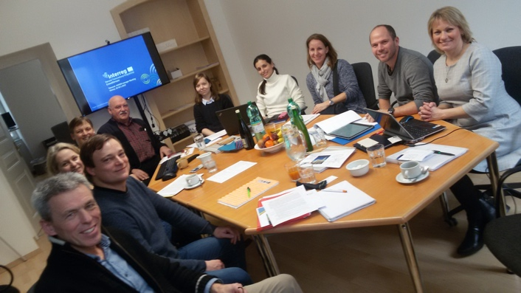
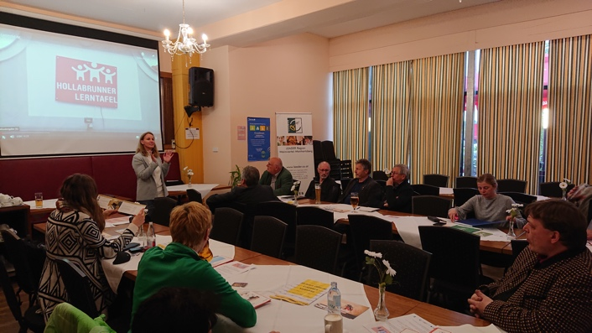
AUSTRIA
Pilot Action for development of BSO services related to micro-regional social projects
March 2018 - May 2019
BSO‘s, Social enterprises, micro-regions
Increased capacities of BSOs for supporting local CF project campaigners
Provision of basic knowledge of CF in general audience at local level
Development of first CF project concepts originating from the micro-region
1st successful campaign implemented!

Slide 4
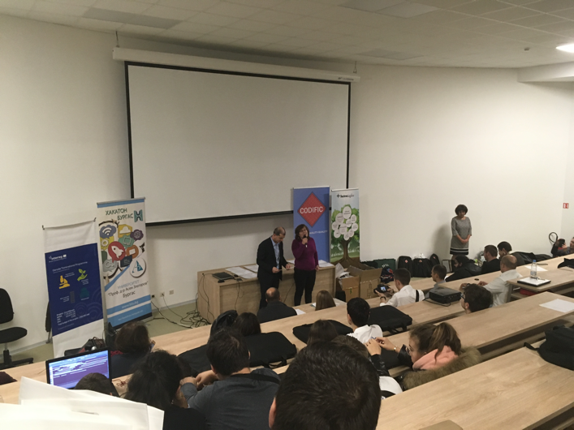
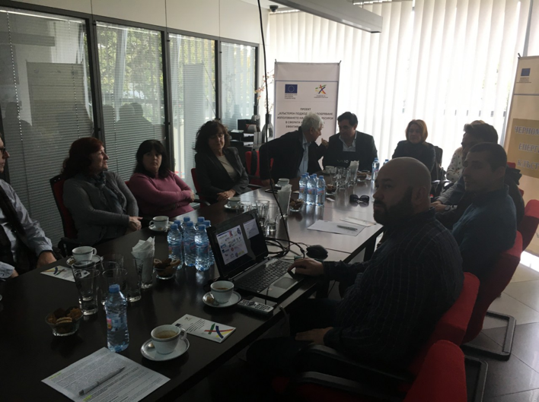
BULGARIA
Hakaton Burgas - Creation of software applications on the topic: "Active Burgas“
14 - 16. 12. 2018
University students, start-ups
Demonstration of public BSO‘s capabilities to motivate, engage and support start-ups and social entrepreneurs in preparation of crowdfunding campaign plans and execution of CF campaigns.

Slide 5
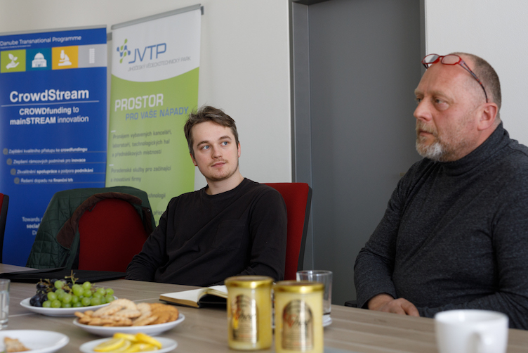
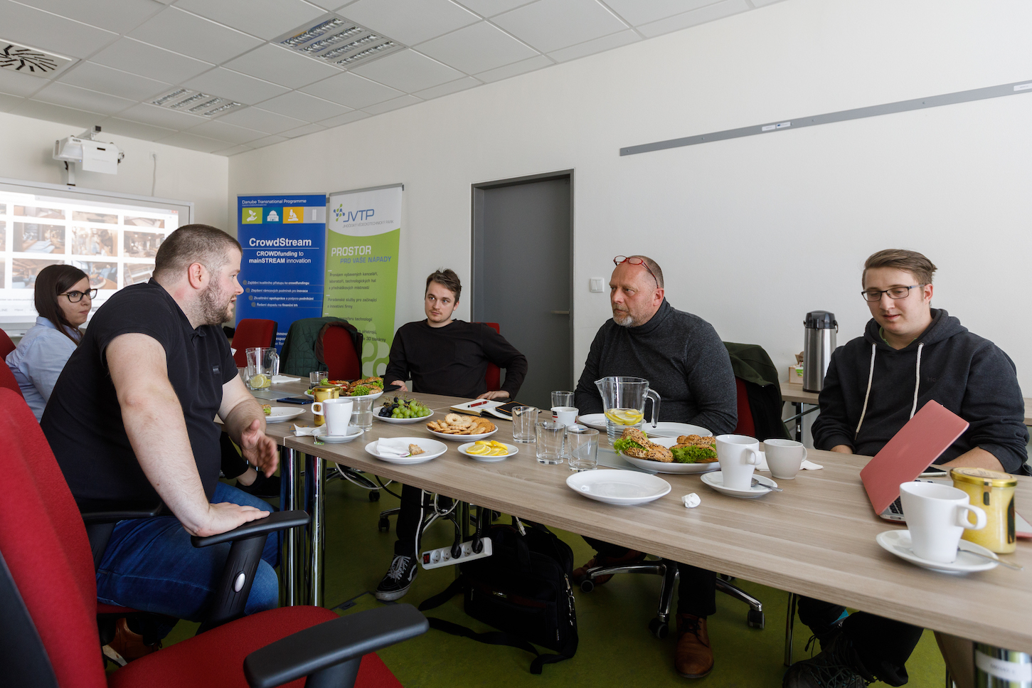
CZECH REPUBLIC
CrowdStream for JIHOCZECH
January - May 2019
Start-ups / Young entrepreneurs / Social enterprises
Integration of CF topic into regional start-up competition
1x training
evaluation methodology + selection
specialized consultancy for 3 selected start-ups (campaign concept, marketing strategy)

Slide 6
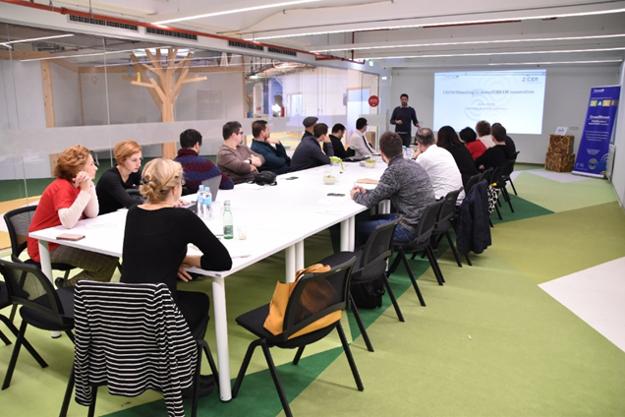
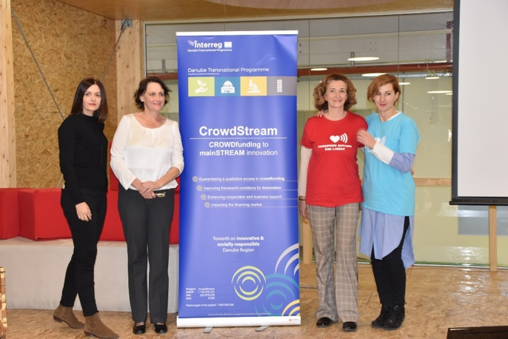
CROATIA
Training on CF campaigns, Video pitching development
19. 9. 2019 – 20. 12- 2019
Innovative SMEs and social entrepreneurs
9 entities trained on the CF fundamentals
9 developed CF campaign plans
2 top ranked competitors awarded with video promotional material
One of two top ranked competitors launched donation based CF campaign and raised 68% of the targeted amount

Slide 7
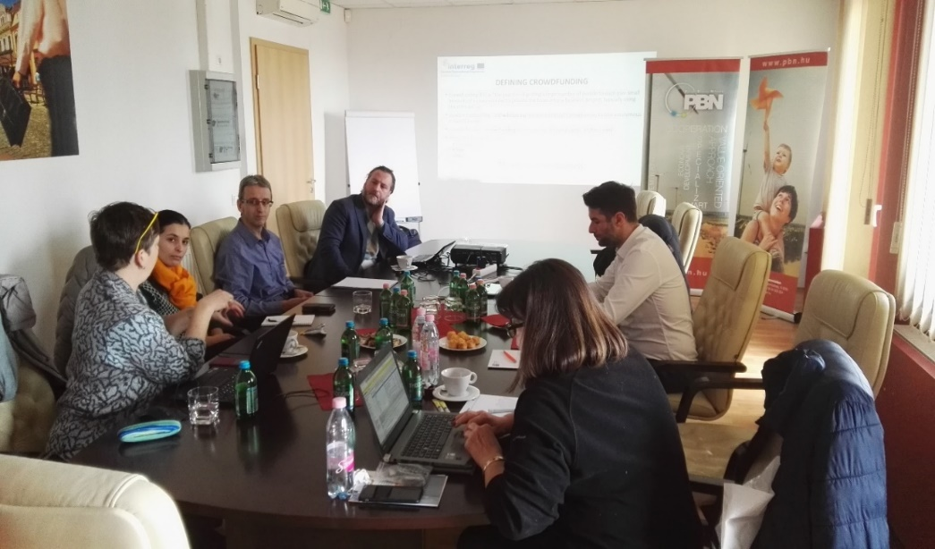
HUNGARY
Crowdfund Your Idea!
19. 11. 2018 – 20. 5. 2019
Innovative SMEs and social entrepreneurs
Preparation of 2 CF campaigns
Popularization of CF
Increased motivation of start - ups and social entrepreneurs to engage in CF
Increased knowledge of start-ups and social entrepreneurs on CF

Slide 8
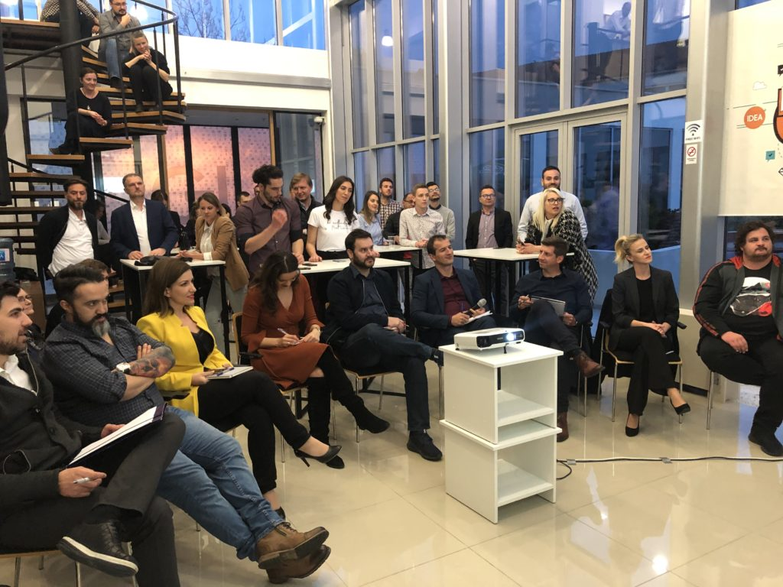
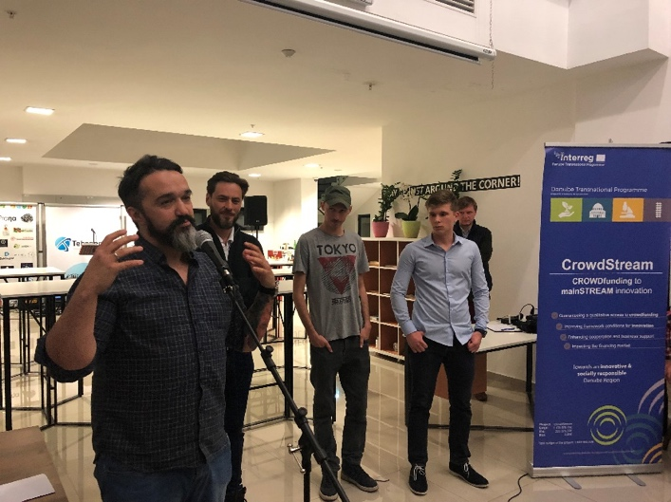
MONTE NEGRO
Empowering pitching potentials EPP
11. 3. 2019 – 25. 5. 2019
National and regional startups, young people with ideas, students
1 set of trainings on CF pitching strategies for 20 participants;
3 ideas for startups creation presented on social medias and to jury -> 2 selected
2 pitching videos created and 2 CF campaigns created for selected ideas

Slide 9
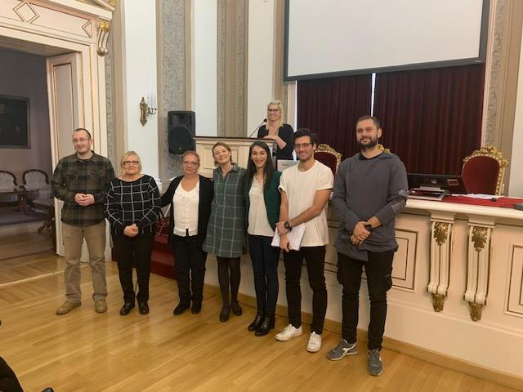
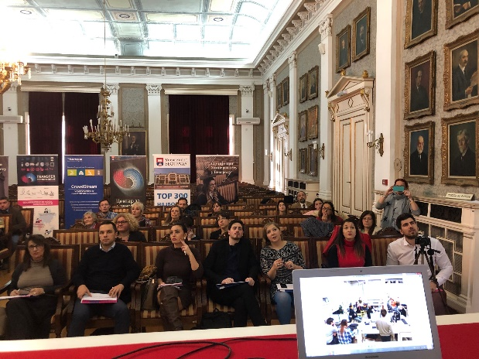
SERBIA
CrowdStream Sprint
5. – 7. 12. 2018
Teams with ideas concerning social issues, ideas in the areas of technology and development, science, creative industry or other type of ideas.
CF campaign development mentoring for 16 teams
Further mentoring for 4 winners
Support for 4 pitching videos creation

Slide 10
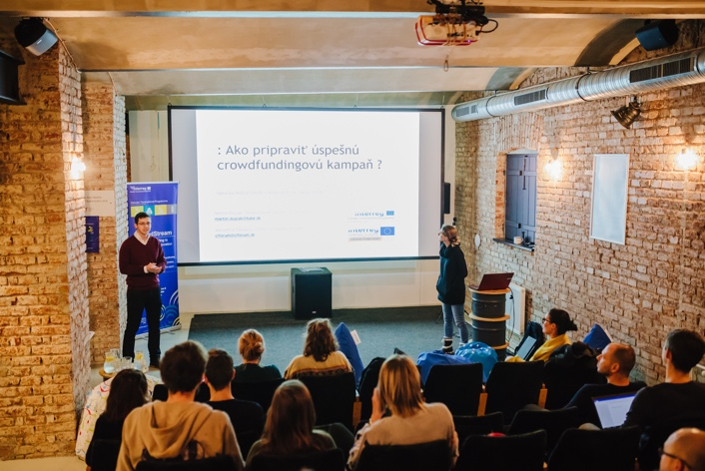
SLOVAKIA
Support program for creation and improvement of crowdfunding campaigns
December 2018 - May 2019
Teams with ideas, especially from Creative industry
3 developed campaigns
including the choosing the proper platform,
creating texts, photo,
video shooting sessions,
release of the campaigns.

Slide 11
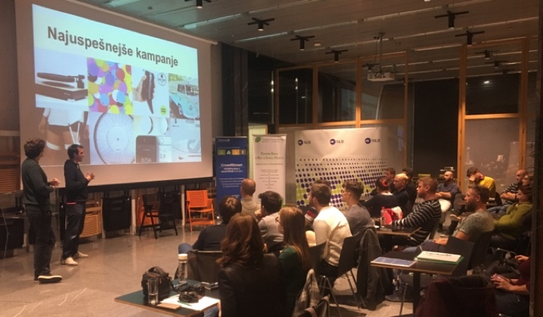
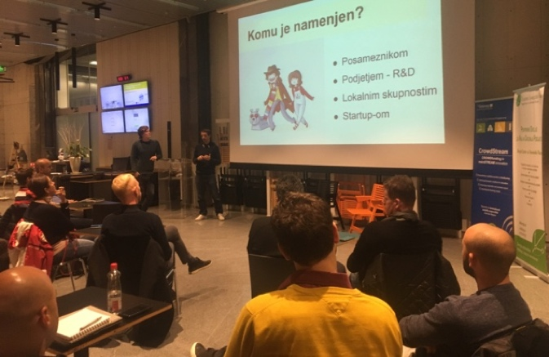
SLOVENIA
CrowdStream Support for Slovenian Crowdfunders
October 2018 - May 2019
Startups, SMEs, potential entrepreneurs / people with innovative business ideas
3 set of trainings with 43 participants,
promotion of the ideas through STP channels and social media resources of the project & partners;
individual consultations and support to candidates.

Slide 12
Main findings / conclusions / recommendations
Pilot Action is very efficient method for raising awareness on CF and related services
It‘s crucial to initiate regular educational / informational program for BSOs (capacity building) on regional level
Integrating Crowdfunding into existing support tools at regional and transregional level is the way to go!
Critical lack of CF support services across all partner‘s regions (excl. Austria)

Slide 13
Thank you for your attention!
Varna, 28 May 2019
Jan Jareš, JAIP

